Slide 1


Detection Of Cyberbullying using
XG BOOST ALGORITHM
Presented by
Batch Number: 18
Y. SAI NITHIN 19311A12F7
B. GURU RAGHAV 19311A12F8
T. SAI KUMAR 19311A12G1
Under the guidance of
Dr. M Sreenivas
Associate Professor
DEPARTMENT OF IT

Slide 2

ABSTRACT
Cyberbullying frequently leads to serious mental and physical distress, particularly for women and children, and even sometimes force them to attempt suicide. Online harassment attracts attention due to its strong negative social impact. Many incidents have recently occurred worldwide due to online harassment, such as sharing private chats, rumors, and sexual remarks. The purpose of this research is to design and develop an effective technique to detect online abusive and bullying messages by merging natural language processing and machine learning. Two distinct features, namely Bag-of-Words (BoW) and Term Frequency-Inverse Text Frequency (TFIDF), are used to analyze. With the development of the Internet, the use of social media has increased dramatically over time and has emerged as the most powerful networking tool of the twenty-first century. Social networking sites and online chat programs give users a platform to share their expertise and talents, but a small number of users abuse this opportunity by threatening other users with cyberbullying assaults, which makes it problematic to use these services. Cyberbullying is regarded as a form of technology abuse. According to a recent analysis of global data, the number of incidences of cyberbullying is rising daily.

Slide 3
PROBLEM DEFINITION AND OBJECTIVE
Problem Definition:
Develop an ML model that can accurately detect instances of cyberbullying in social media posts and online forums. The model should be trained on a dataset of labeled examples of cyberbullying, and should be able to identify patterns of language, behavior, and context that are indicative of cyberbullying. The goal is to create a tool that can help social media platforms and online communities to proactively identify and address instances of cyberbullying, in order to create safer and more welcoming online environments.
Objective:
Develop an ML model that can accurately detect instances of cyberbullying in real-time across multiple online platforms, including social media, chat rooms, and messaging apps.
Optimize the ML model to reduce false positives and false negatives, and achieve high accuracy in detecting instances of cyberbullying.
Evaluate the effectiveness of the ML model in detecting cyberbullying, and refine the model as needed to improve its performance.

Slide 4

ADVANTAGES
EXISTING MODEL
Decision tree techniques are used in the current machine learning application for cyberbullying detection, although this algorithm is ineffective at categorizing the cyberbullying texts.
Disadvantages of the Existing System:
An unstable decision tree might result from a little change in the data that has a huge impact on the decision tree's structure.
Compared to other algorithms, a decision tree's calculations occasionally become far more complicated.
It takes more time to train a decision tree model.
Because of the intricacy and length of time required, decision tree training is relatively expensive.
Regression and the prediction of continuous values cannot be done effectively with the Decision Tree algorithm.

Slide 5
PROPOSED SYSTEM
The cyberbullying detection structure, which is divided into two main components, is depicted in NLP (Natural Language Processing) refers to the first section, and ML (machine learning) refers to the second section . The raw text cannot be used directly by the machine learning algorithms. Therefore, we must transform the algorithms to vectors or integers before applying them. Thus, for the following stage, the processed data is transformed into a Bag-of-Words. TF-IDF: We also take into account this attribute for our model. A statistical technique called TF-IDF (Term Frequency-Inverse Document Frequency) can assess how pertinent a term is to a document within a collection of documents. We use SMOTE, Xgbooster for enhancement.

Slide 6
METHODOLOGY
Natural Language processing: The real-world posts or text contain various unnecessary characters or text. For example, numbers or punctuation is irrelevant to bullying detection. Before applying the machine learning algorithms to the comments, we need to clean and prepared them for the detection phase. In this phase, various processing task including removal of all irrelevant characters like stopwords, punctuation and numbers, tokenizations, stemming etc. After the pre-processing, we prepare the two important features of the texts as follows:
1) Bag-of-Word: The machine learning algorithms cannot work directly with the raw text. So before applying the algorithms we must convert them to vectors or numbers. So, the processed data is converted to Bagof-Words (BoW) for the next phase.

Slide 7
METHODOLOGY
2) TF-IDF: This is another feature that we consider for our model. TF-IDF (Term Frequency-Inverse Document Frequency) is a statistical measure that can evaluate how relevant a word is to a document in a collection of documents. In bag of words, every word is given equal importance while in TF-IDF the words that occur more frequently should be given more importance as they are more useful for classification.
• Machine Learning: This module involves in applying various machine learning approaches Random Forest to detect the bullying message and text. The classifier with the highest accuracy is discovered for a particular public cyberbullying dataset.

Slide 8
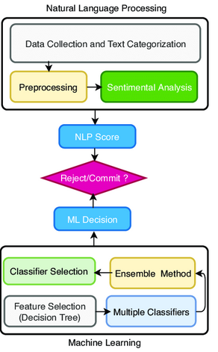
Fig 1 : Natural Language Processing

Slide 9
Random Forest Classifier: Random Forest classifier consists of multiple decision tree classifiers. Each tree gives a class prediction individually. The maximum number of the predicted class is our final result. This classifier is a supervised learning model which provides accurate result because several decision trees are merged to make the outcome. Instead of relying on one decision tree, the random forest takes the prediction from each generated tree and based on the majority votes of predictions, and it decides the final output.
XGBoost: Extreme Gradient Boosting is a gradient boosting library in python. It is based on gradient boosted decision trees. It is a boosting algorithm which is used in various competitions like kaggle for improving the model accuracy and robustness. Decision tree-based algorithms are considered best for small/medium structured or tabular data. Building models using XGBoost is quite easy. But improving its efficiency is really hard. We have various parameters in XGBoost, which requires tuning.

Slide 10
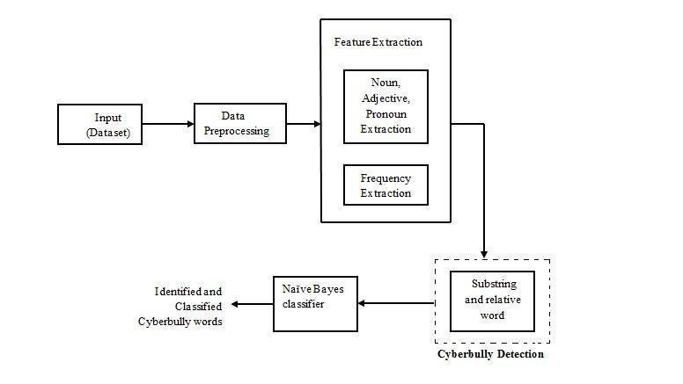
XGBOOST ALGORITHM

Slide 11
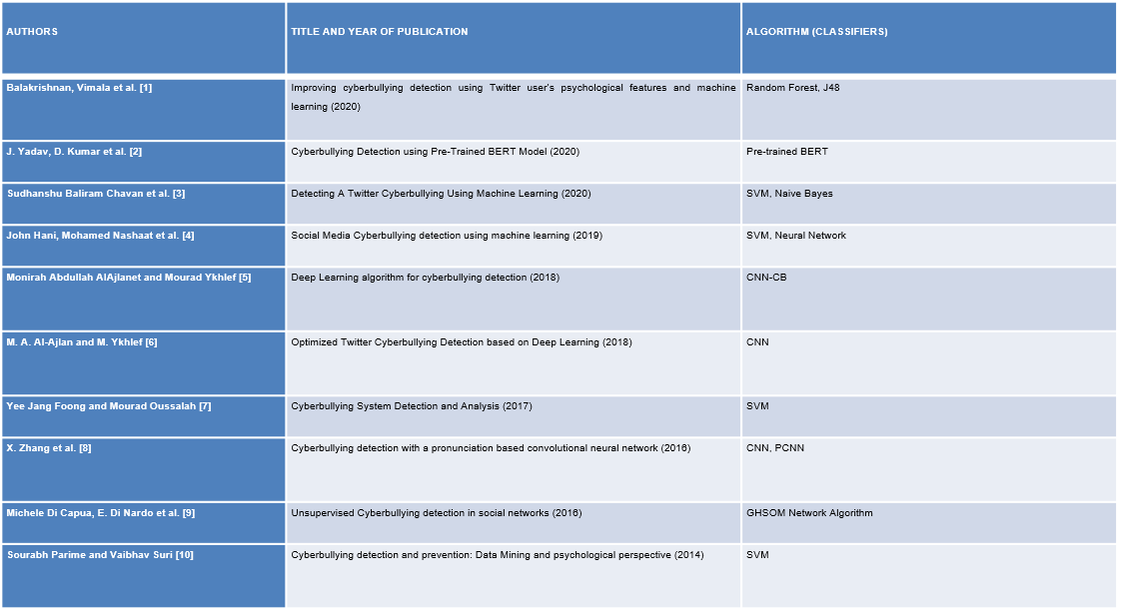
LITERATURE SURVEY

Slide 12
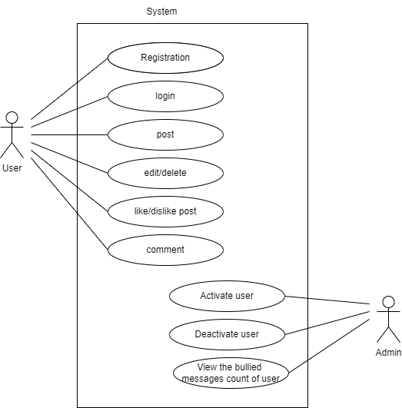
USE CASE UML DIAGRAM
USE CASE UML DIAGRAM

Slide 13
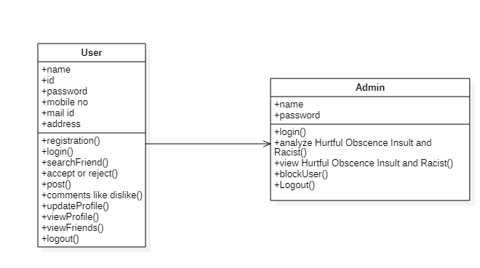
CLASS UML DIAGRAM

Slide 14
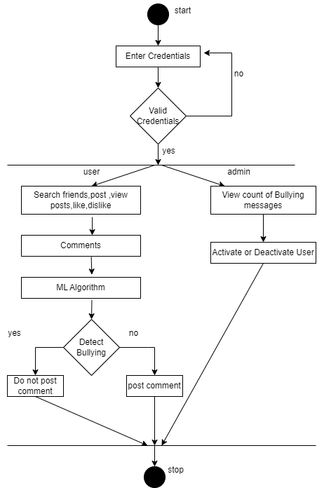
ACTIVITY UML DIAGRAM

Slide 15
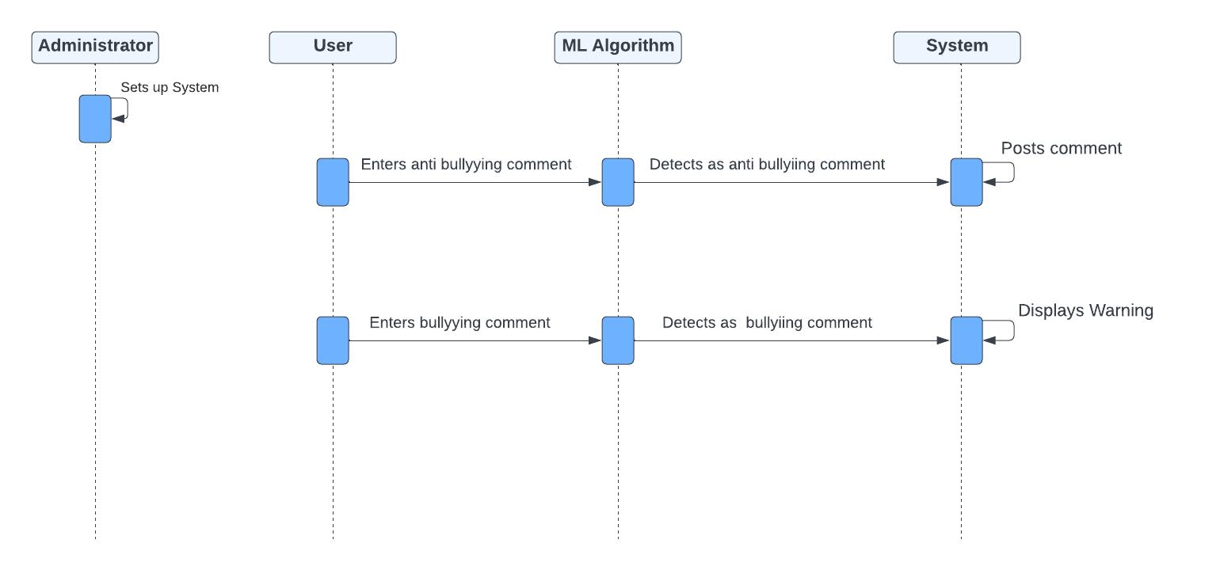
SEQUENCE UML DIAGRAM

Slide 16
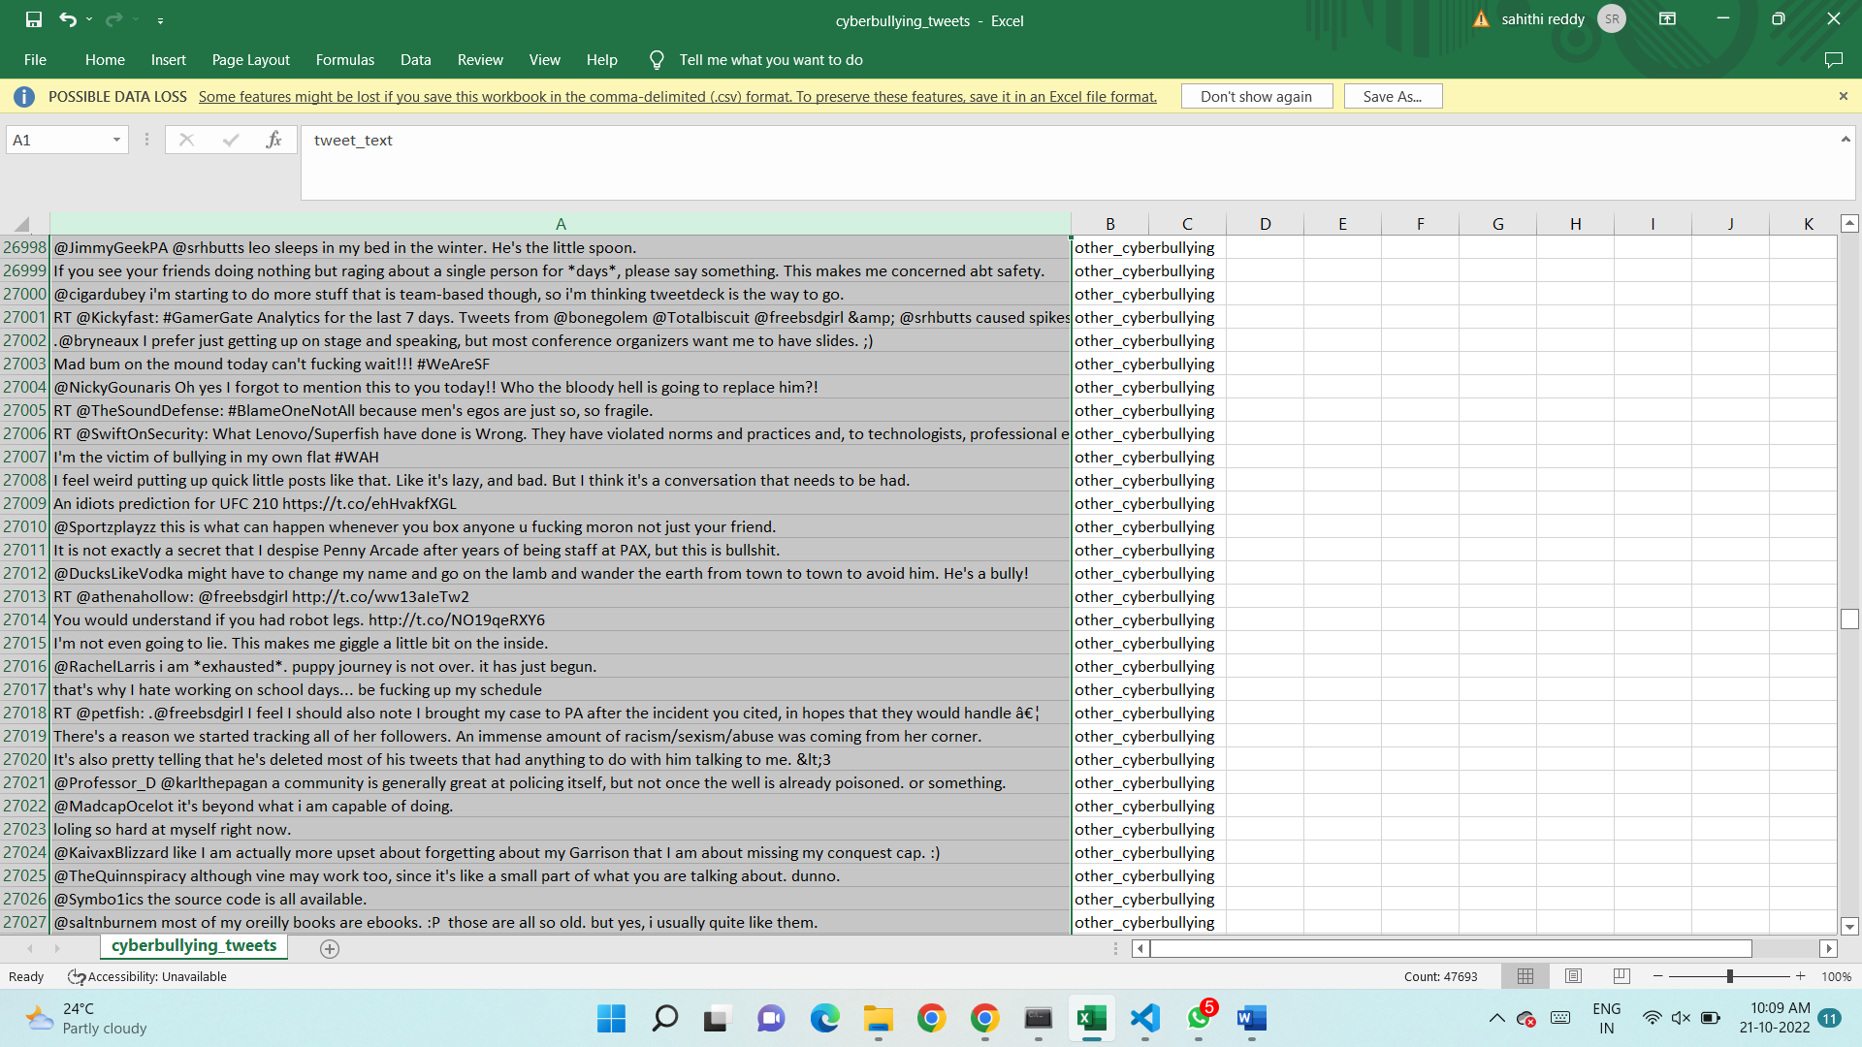
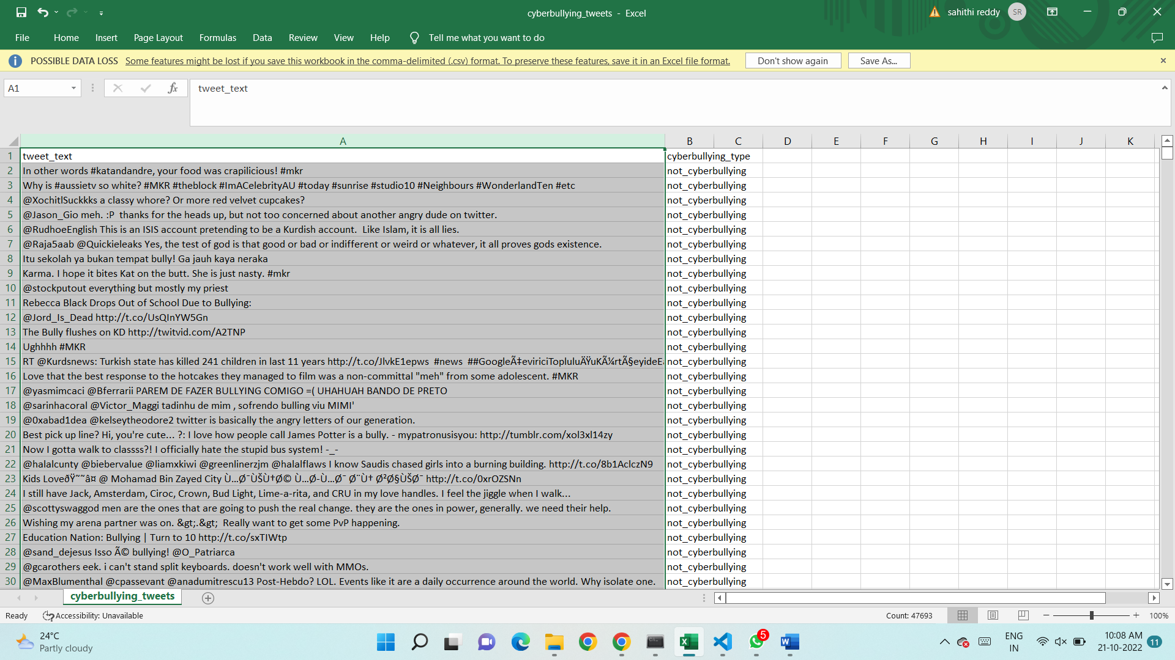
DATASET USED
Sample of data set shown here which are collected from twitter

Slide 17
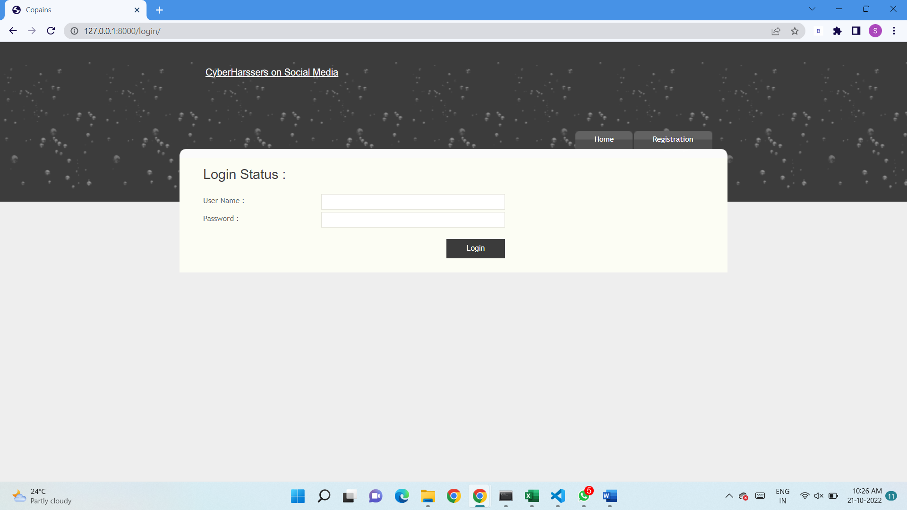
Result Description
Fig 1: This is the login page to the platform

Slide 18
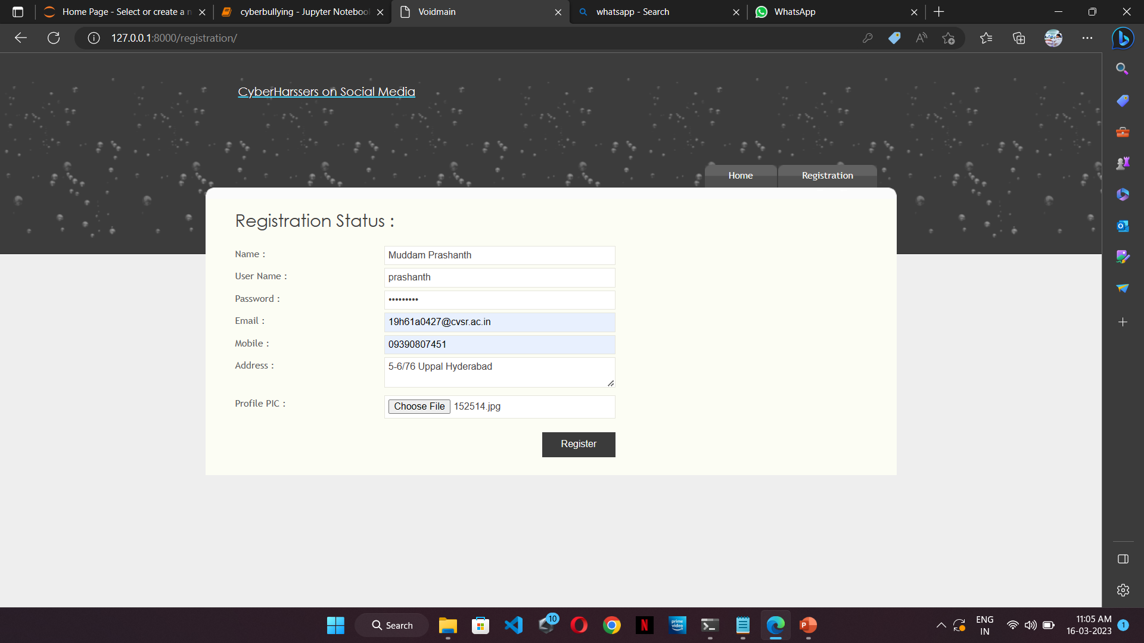
Fig.2: It shows the new user registration process

Slide 19
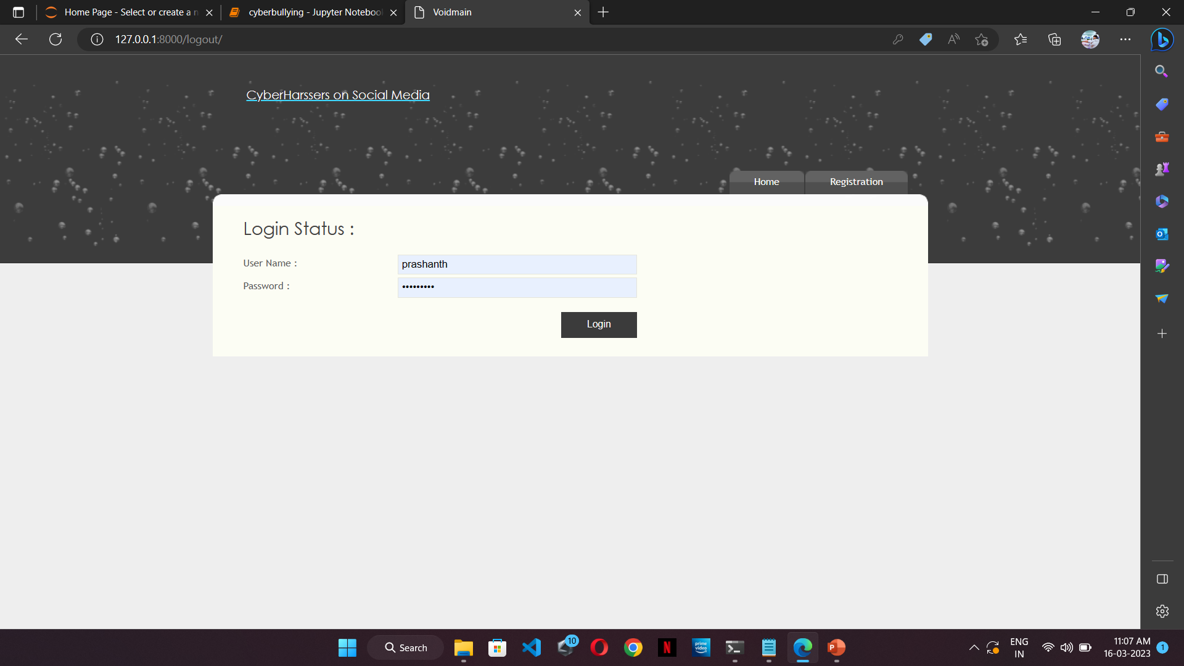
Fig 3: This shows that one can login with their credentials

Slide 20
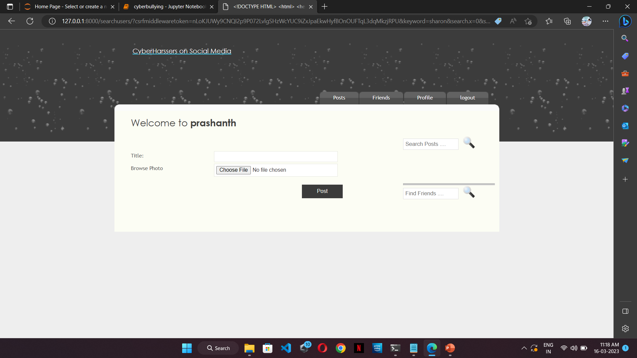
Fig 4: This shows the users home page just after logging in

Slide 21
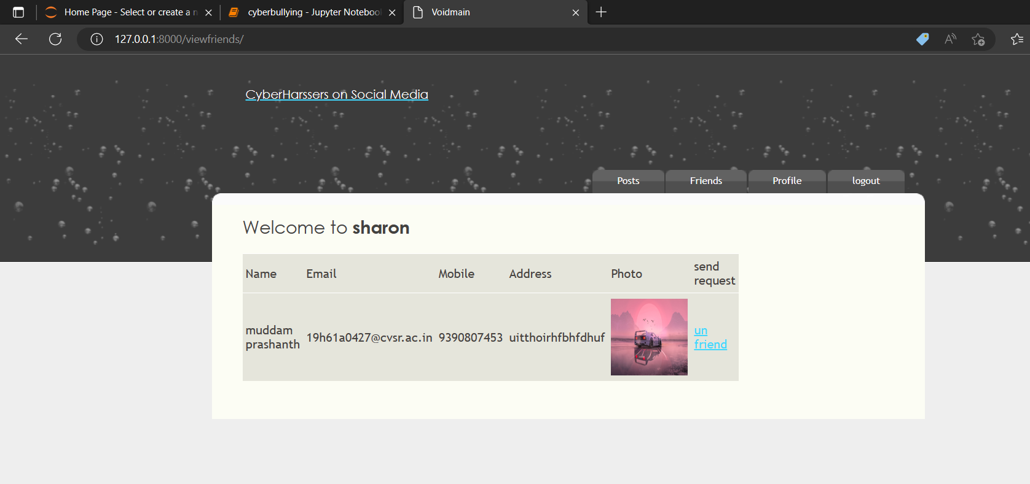
Fig 5: This shows the other users web page where one can accept their friend requests

Slide 22
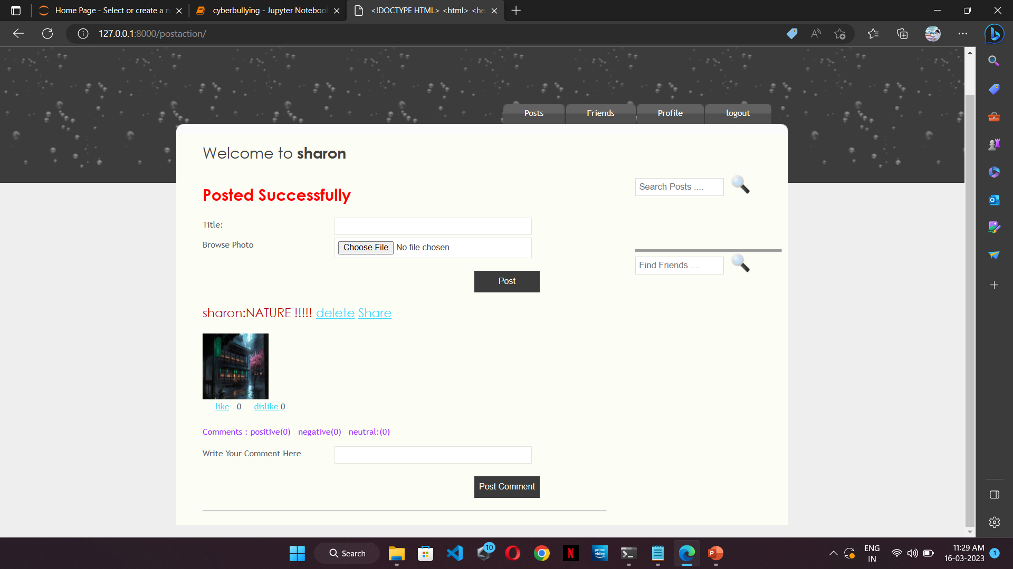
Fig 6: This shows the post that a user can upload. Here, user named Sharon has posted a picture with the description Nature!

Slide 23
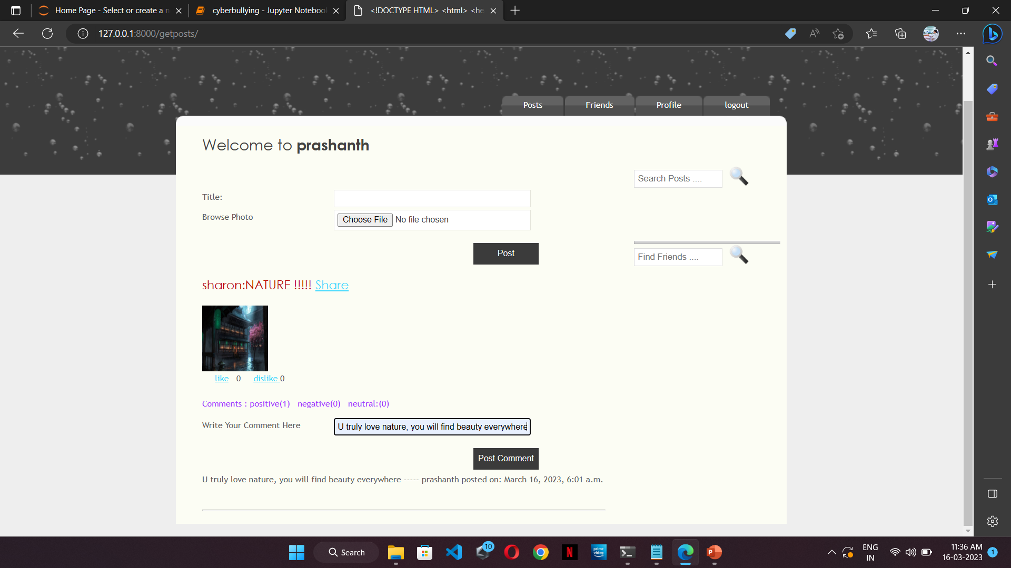
Fig 7: This shows the anti-bullying comment that is posted by Prashanth on Sharon’s post.

Slide 24
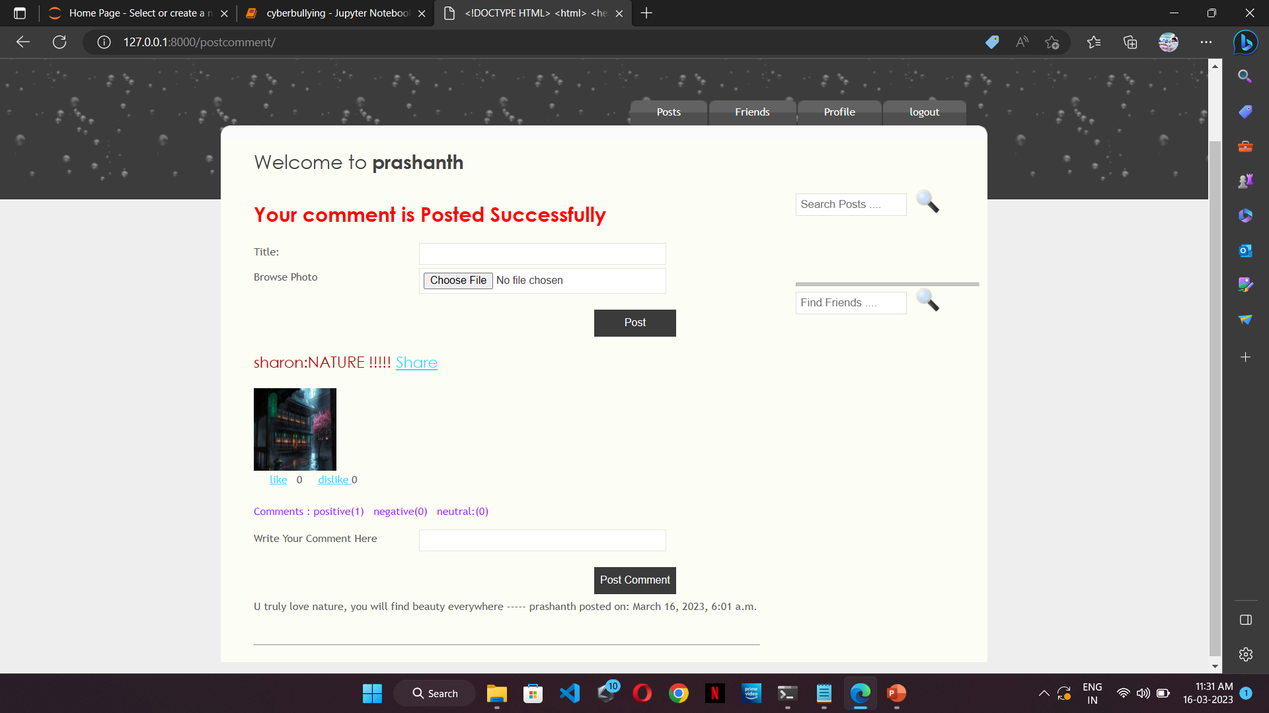
Fig 8: This shows that the anti-bullying comment is posted successfully.

Slide 25
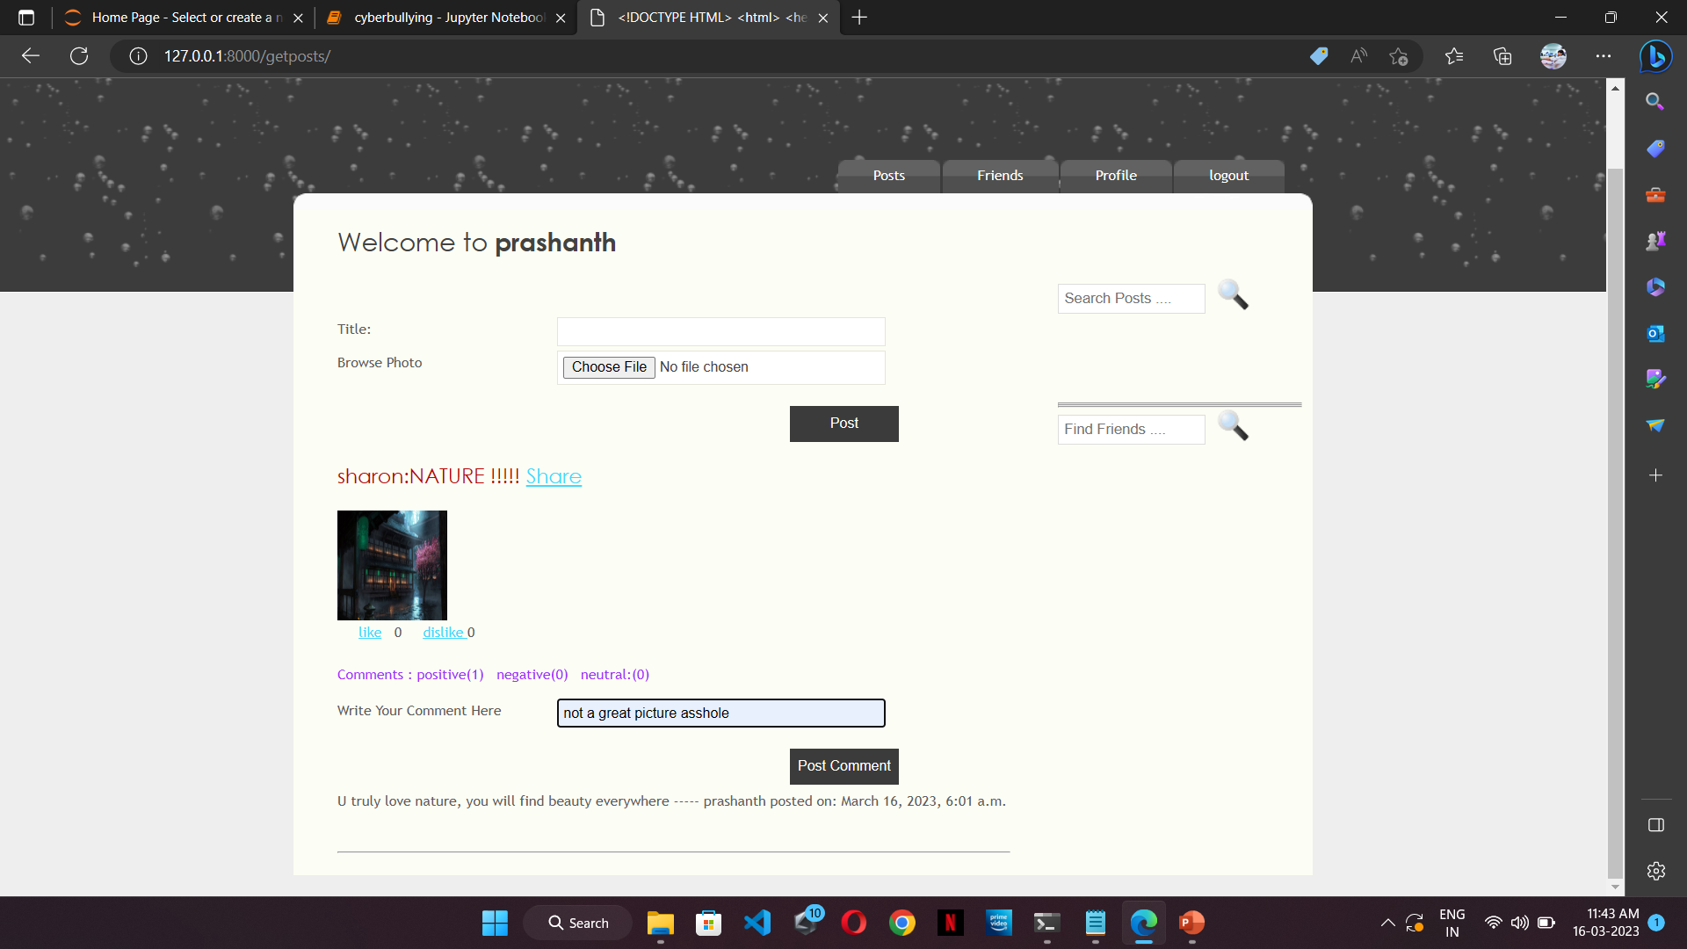
Fig 9: This shows that the comment is filtered when a user tries to post a bullying comment

Slide 26
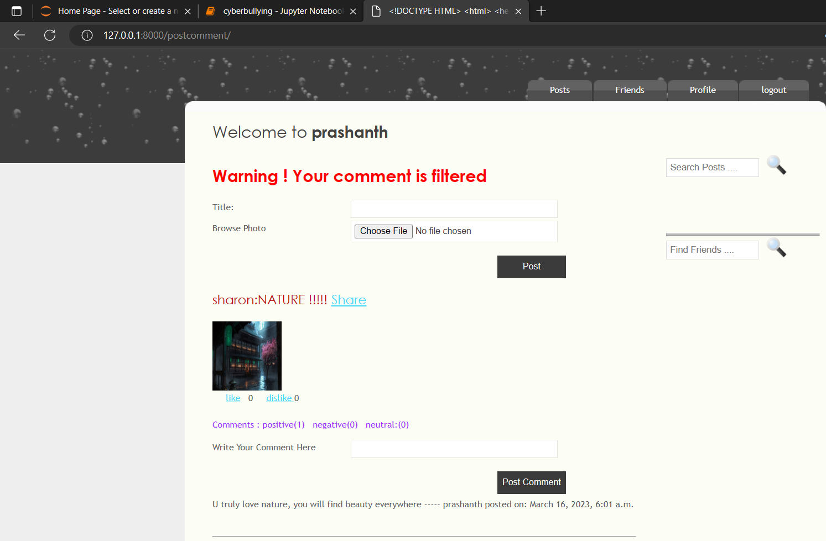

Slide 27
outputs
The following is the tabular form of testcases:
TEST CASE | OUTPUT | STATUS
Comment1: u truly love nature | Identified as anti-bullying | Your comment is posted Successfully
Comment2: Not a great picture Asshole | Identified as bullying | Warning! Your comment is filtered
Comment3: Beautiful pic | Identified as anti-bullying | Your comment is posted Successfully
Comment4: Bullshit | Identified as bullying | Warning! Your comment is filtered
Comment5: looks awesome | Identified as anti-bullying | Your comment is posted Successfully
Table : Table of Testcases

Slide 28
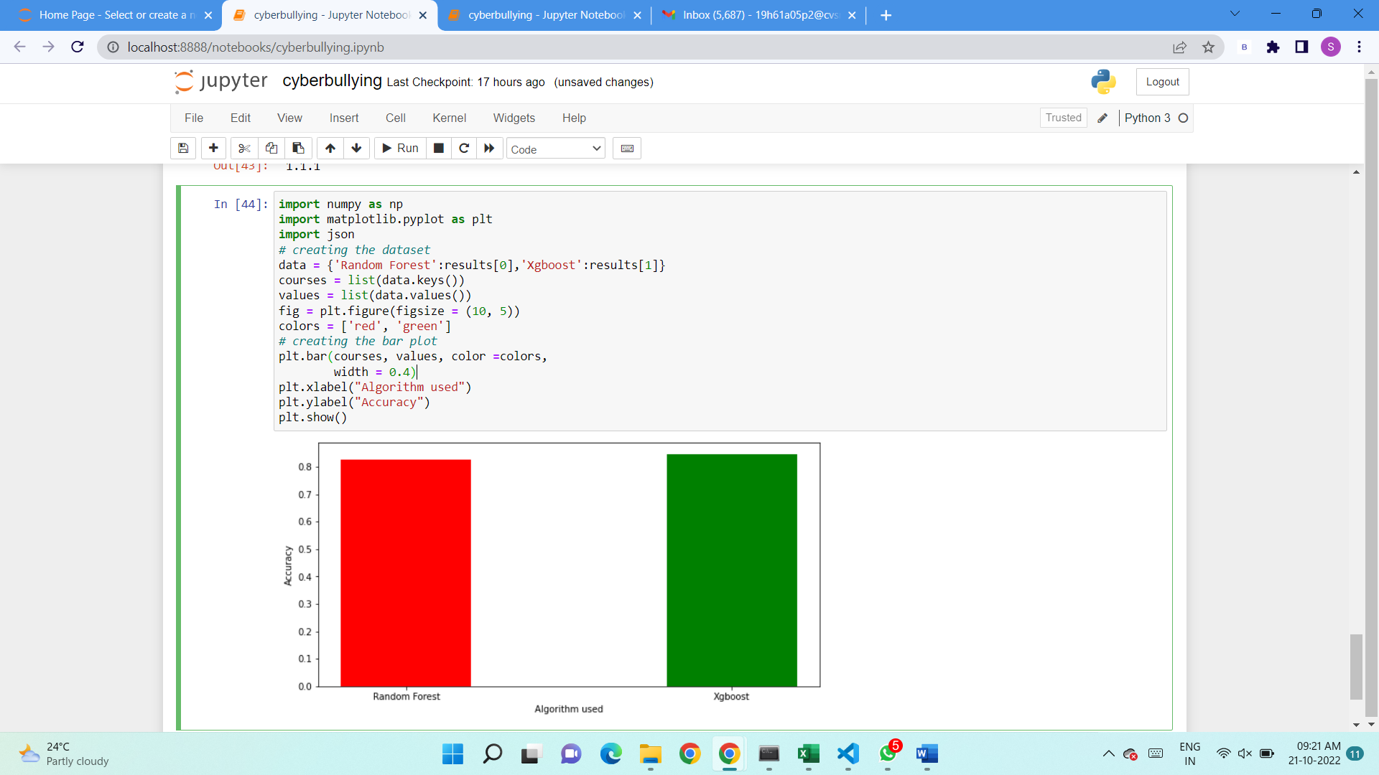
results
Fig : Result Analysis

Slide 29
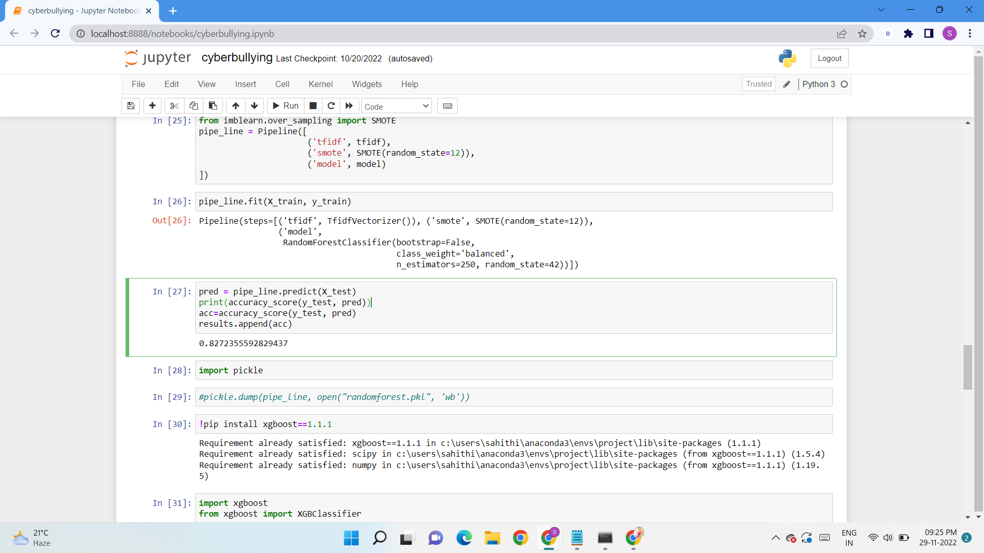
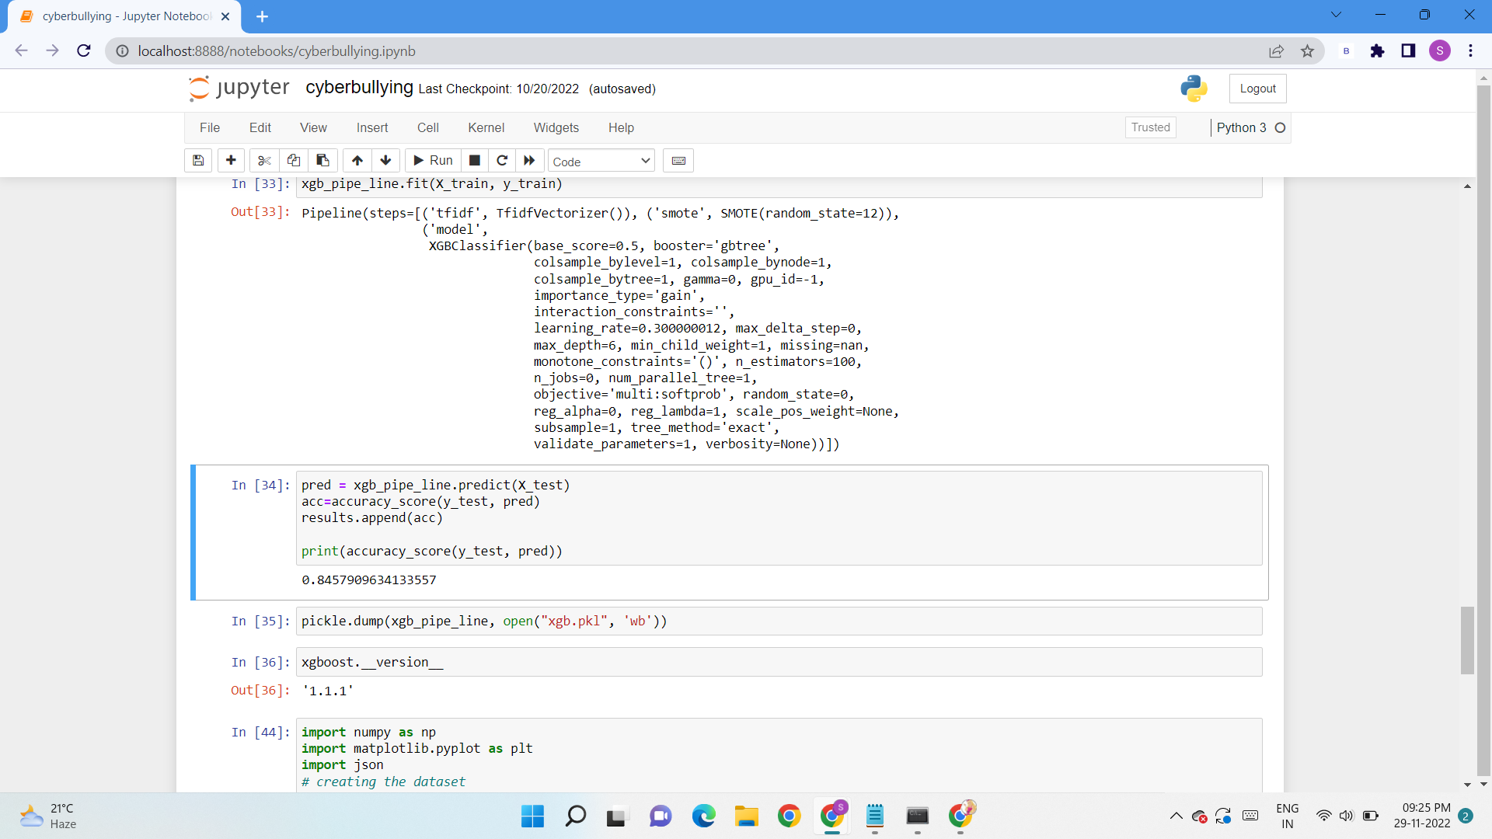
RESULTS AND DISCUSSIONS

Slide 30
CONCLUSION&FUTURE SCOPE
In particular, cyberbullying has become more common and has begun to raise significant social issues with the rising prevalence of social media sites and increased social media use by teenagers. There needs to design automatic cyberbullying detection method to avoid bad consequences of cyber harassment. Considering the significance of cyberbullying detection, in this study, we investigated the automated identification of posts on social media related to cyberbullying by considering two features BoW and TF-IDF. Four machine learning algorithms are used to identify bullying text and SVM for both BoW and TF-IDF. In future we are planning to design a framework for automatic detection and classification of cyberbullying from Bengali texts using deep learning algorithms.
Future Scope:
As of now, the prediction is limited to text and can be enhanced further to predict the Cyberbullying from images, videos and emojis.
The extent of the prediction can be enhanced to even include more languages.

Slide 31
Thank you

